Slide 1
Raster Intervals
An Approximation Technique for Polygon Intersection Joins
By Thanasis Georgiadis and Nikos Mamoulis
Dimitrios Kyriakopoulos
Dimitrios Rontogiannis

Slide 2
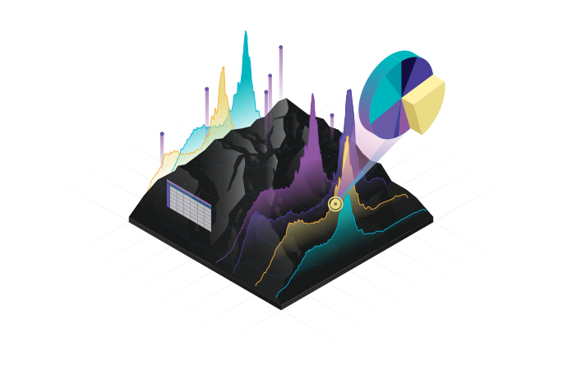
THE PROBLEM
Large object collections (rivers, lakes, cities, etc.)
Objective: find which objects intersect
Naïve algorithm is computationally expensive
Need for efficient filtering algorithms

Slide 3
APPLICATIONS
GIS (Geographic Information Systems)
Computer Graphics
Neuroscience
Semantic Web
Notes:
GIS: Find the intersection of two data layers
Computer Graphics: Detect the interference between geometric models
Neuroscience: Determine where to put synapses between neurons in brain models
Semantic Web: Identify topological relations between polygons corresponding to sources of the Semantic Web and interlink them in the Linked Open Data cloud

Slide 4
CONTRIBUTION
Novel representation of objects
Novel join algorithm
Space/Time efficient

Slide 5
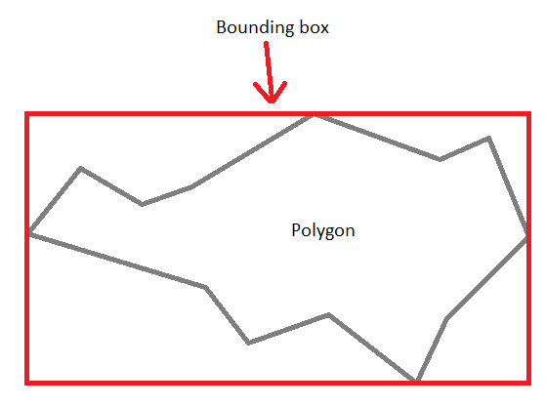
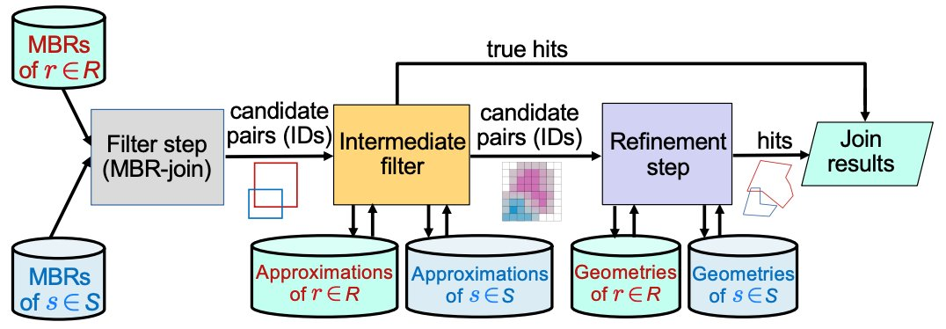
BACKGROUND
The join is performed in two steps:
Filter step: objects whose MBRs intersect are candidates
Refinement step: each of the candidate pairs is verified for intersection
Spatial intersection join pipeline
Notes:
The minimum bounding rectangle (MBR), also known as bounding box (BBOX) or envelope, is an expression of the maximum extents of a two-dimensional object or set of objects within its x-y coordinate system.
The refinement step of polygon-polygon joins may take more than 99% of the overall join time
There are several attempts in the literature to avoid as much as possible the refinement ste

Slide 6
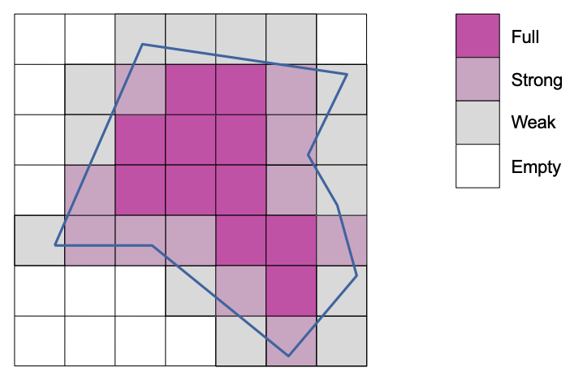
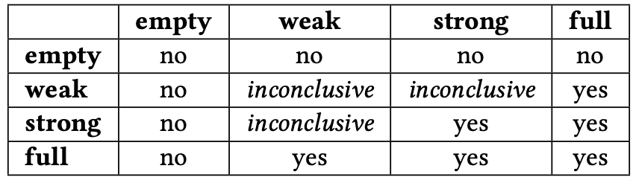
BACKGROUND (cont.)
Zimbrao and de Souza -> raster approximation of objects
Define a grid of at most k square cells (side ω2^{k})
Re-scaling (computationaly expensive)
Use the cell’s types to conclude whether the objects intersect
Notes:
Raster approximation: each cell belongs to one of the following four types: full (the object completely covers the cell), strong (the object covers more than 50% of the cell), weak (the object covers at most 50% of the cell), or empty (the object is disjoint with the cell)
If the cells of 𝑅𝐴(𝑟) are smaller than the cells of 𝑅𝐴(𝑠), groups of neighboring cells in 𝑅𝐴(𝑟) are combined to infer the type of a larger cell that is perfectly aligned with a cell of 𝑅𝐴(𝑠).

Slide 7
OBJECTS' REPRESENTATION
Object rasterization
Raster encoding
Intervalization

Slide 8
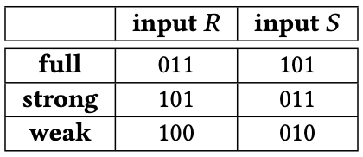
OBJECT RASTERIZATION + RASTER ENCODING
Superimpose a 2^{N}x2^{N} grid over the data space
Identify intersecting cells per object and classify cells as full, strong or weak
Encode cell types differently based on the source of the object
Notes:
we use a different encoding for the cell types depending on whether the object comes from join input 𝑅 or S

Slide 9

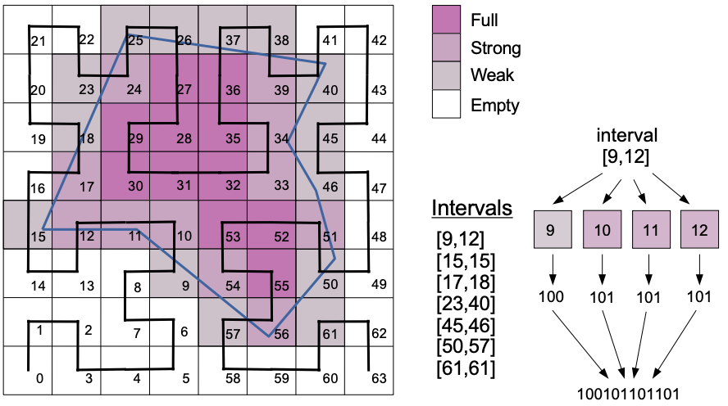
INTERVALIZATION
Hilbert curve to order cells in the grid
Representation as a list of intervals formed by consecutive cells according to the Hilbert order.

Slide 10
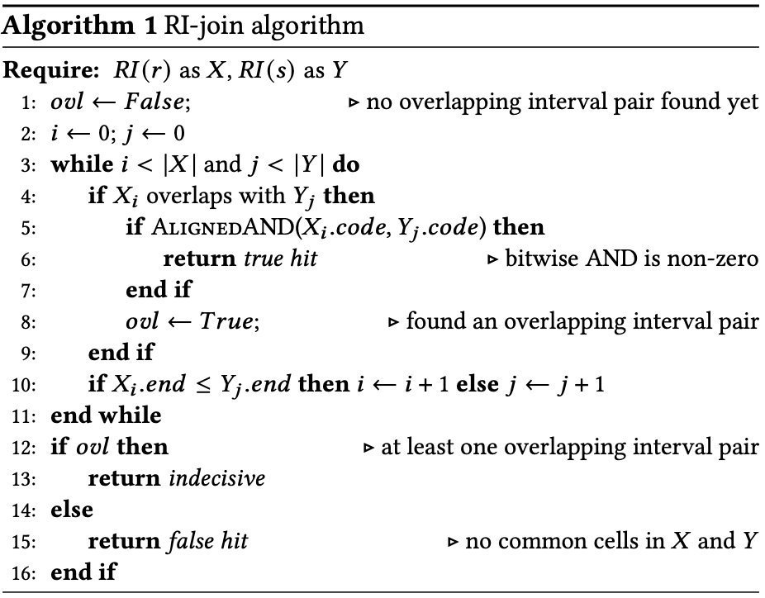
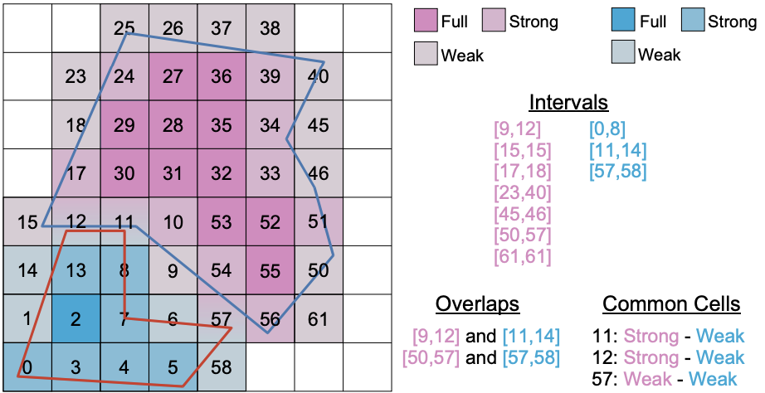
ALGORITHM
𝑟 and 𝑠 definitely intersect
𝑟 and 𝑠 definitely do not intersect
we cannot conclude about the intersection of 𝑟 and 𝑠
Notes:
With a small change in the algorithm we can check for within

Slide 11
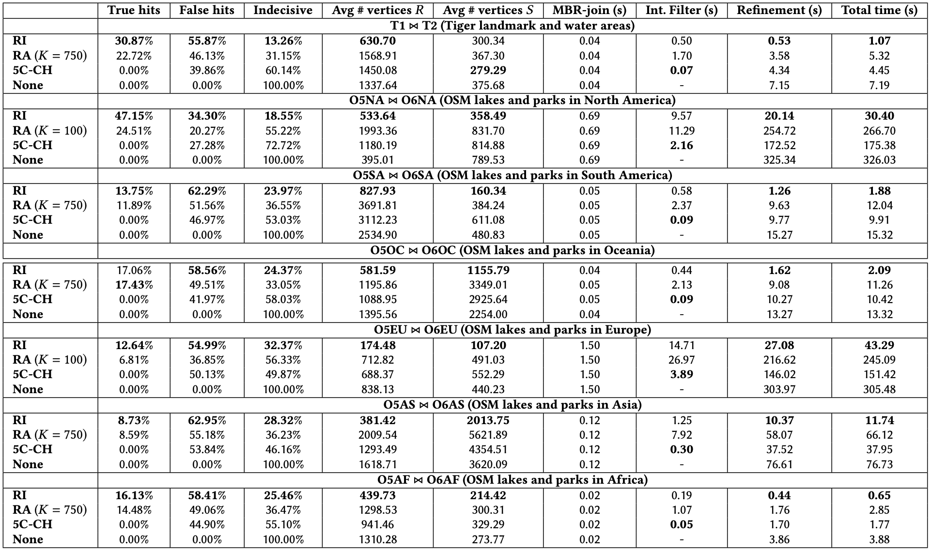
EXPERIMENTS

Slide 12
CONCLUSION
Raster Intervals: a technique for encoding and compressing raster approximations of polygons
Achieves a speedup of at least 3x over previous methods
Maintains low space complexity

Slide 13
ROADMAP
Find datasets and experiment with them (15/4-21/4)
1
Implement baseline: MBR filter (22/4 - 28/4)
2
Run baseline algorithm on datasets (29/4 - 5/5)
3
Implement object rasterization + bitstring encoding (6/5 - 12/5)
4
Implement intermediate filter algorithm (13/5 - 19/5)
5
Run experiments (20/5 - 26/5)
6
Improve paper (27/5 - 2/6)
7
Prepare for in-class representation (3/6 - 11/6)
8

